Slide 1
Decision Support System

Slide 2
What is DSS?
A decision support system (DSS) is a computer program used to improve a company's decision-making capabilities. It analyzes large amounts of data and presents an organization with the best possible options available.
DSSes bring together data and knowledge from different areas and sources to provide users with information beyond the usual reports and summaries. This is intended to help organizations make informed decisions.

Slide 3
What is DSS?
A decision support application might gather and present the following typical information:
Comparative sales figures between one week and the next.
Projected revenue figures based on new product sales assumptions.
The consequences of different decisions.

Slide 4
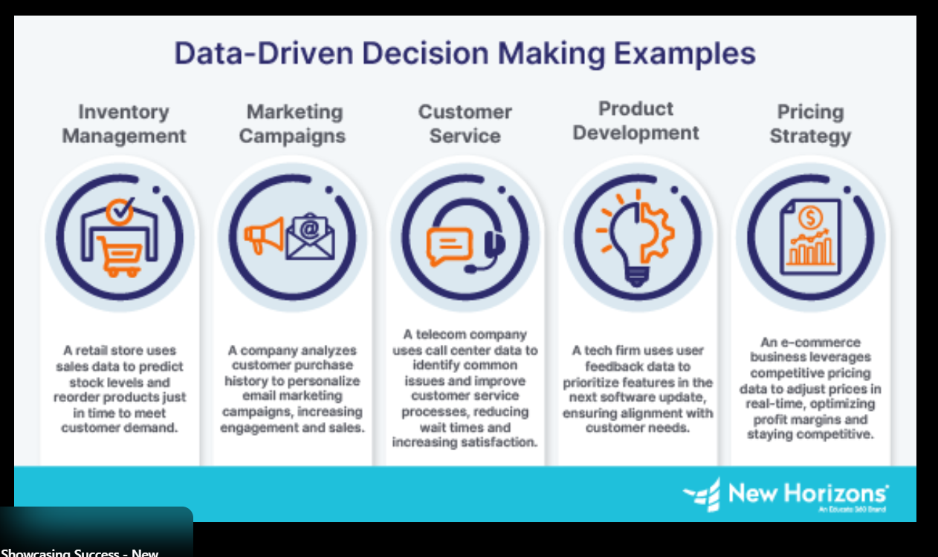

Slide 5
Advantages of DSS
Disadvantages of DSSS
Enable informed decision-making. By taking multiple different data sources into account, DSSes can facilitate better, up-to-date and informed decisions.
Consider different outcomes. DSSes consider different business outcomes, as possible decisions are based on current and historical company data.
Increase efficiency. DSSes automate the analysis of large data sets.
Provide better collaboration. DSS tools might also include communication and collaboration features.
Enable flexibility. DSSes can be used by many different industries.
Handle complexity. DSSes can handle complex problems that have multiple interdependencies and variables.
Cost. Expenses for developing, implementing and maintaining DSSes can be high, which can limit their use by smaller organizations.
Dependence. Developing an over-reliance on a DSS eventually takes away from the subjectivity involved in decision-making.
Complexity. DSSes must consider all aspects of a given problem, which requires a lot of data. They can also be complex to design and implement.
Security. Data that DSSes use might involve sensitive or critical data, meaning that an increased focus on security is required.
Employee resistance. Some employees might be resistant to any workflow change based on the recommendations of a machine.

Slide 6
What is OLAP?
OLAP (Online Analytical Processing) is implemented in data warehouses to allow fast, multidimensional analysis of large datasets. Implementation includes the design, building, and deployment of OLAP cubes and related components.

Slide 7
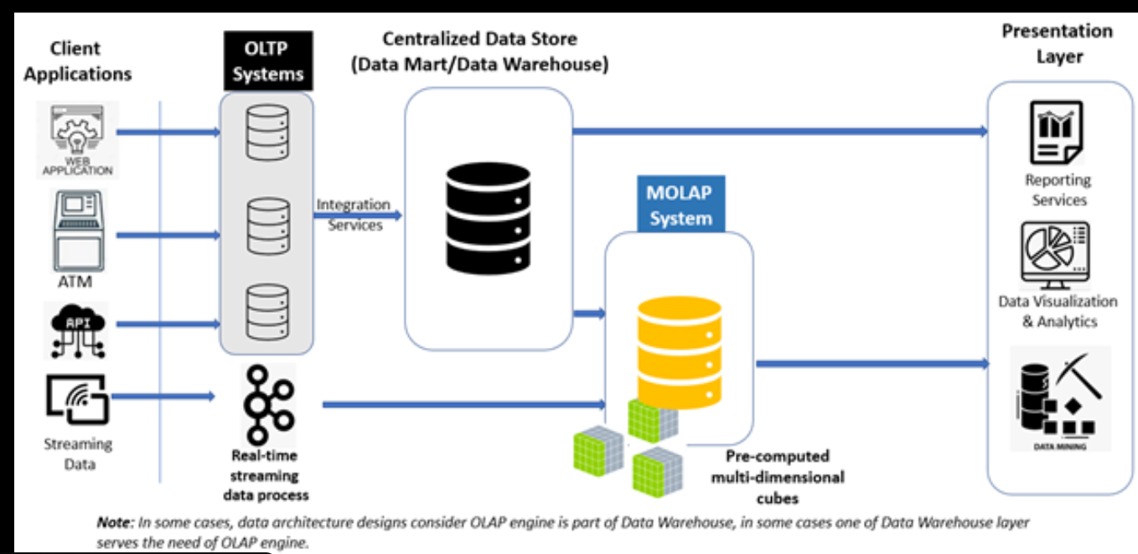

Slide 8
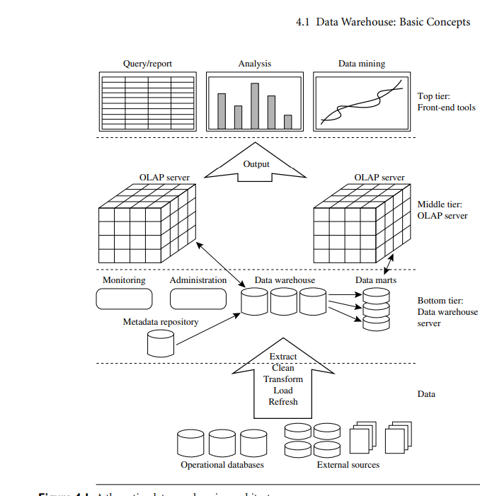

Slide 9
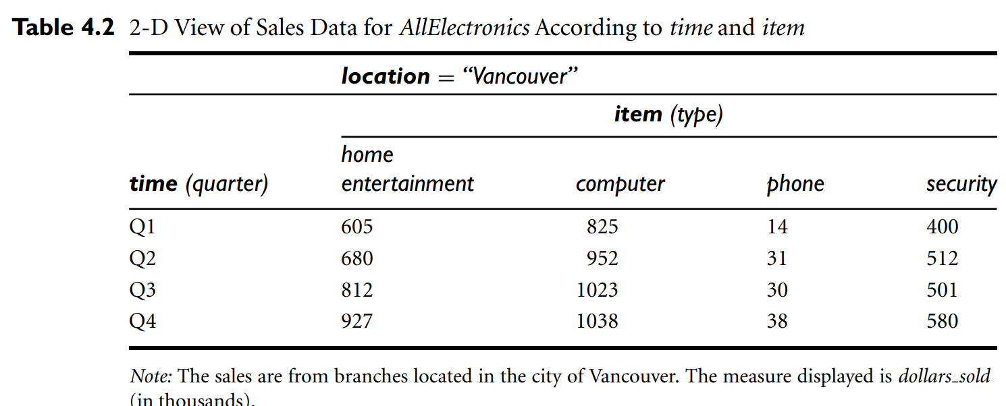

Slide 10
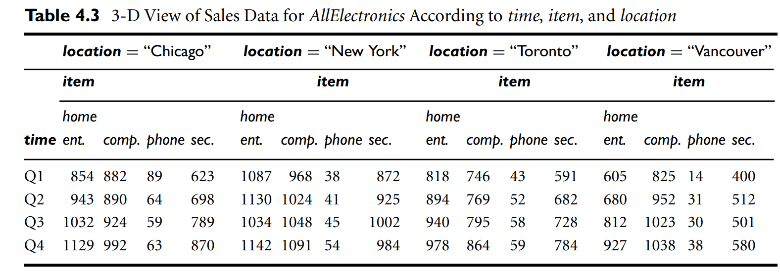

Slide 11
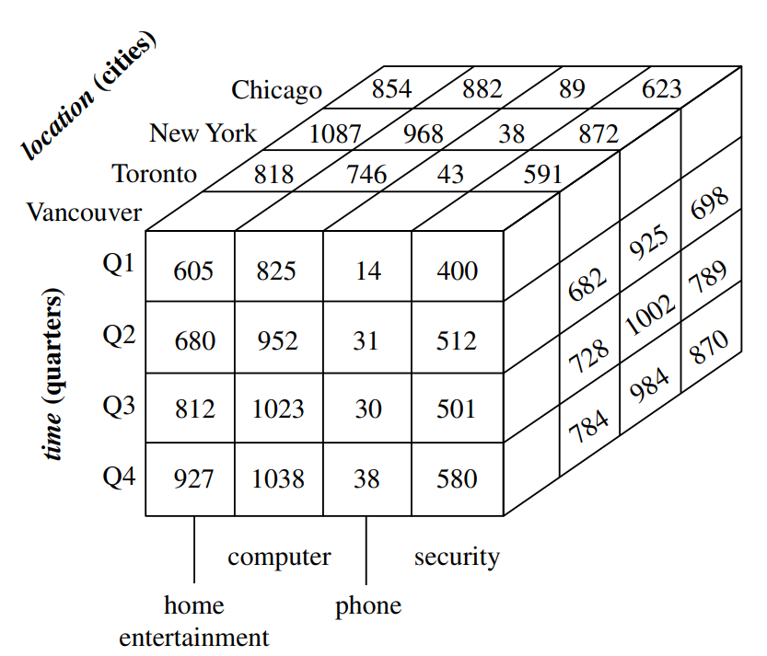

Slide 12
What is data warehouse?
Defined in many different ways, but not rigorously.
A decision support database that is maintained separately from the organization’s operational database
Support information processing by providing a solid platform of consolidated, historical data for analysis.
“A data warehouse is a subject-oriented, integrated, time-variant, and nonvolatile collection of data in support of management’s decision-making process.”—W. H. Inmon
Data warehousing:
The process of constructing and using data warehouses

Slide 13
Data Warehouse—Subject-Oriented
Organized around major subjects, such as customer, product, sales.
Focusing on the modeling and analysis of data for decision makers, not on daily operations or transaction processing.
Provide a simple and concise view around particular subject issues by excluding data that are not useful in the decision support process.

Slide 14
Data Warehouse—Integrated
Constructed by integrating multiple, heterogeneous data sources
relational databases, flat files, on-line transaction records
Data cleaning and data integration techniques are applied.
Ensure consistency in naming conventions, encoding structures, attribute measures, etc. among different data sources
E.g., Hotel price: currency, tax, breakfast covered, etc.
When data is moved to the warehouse, it is converted.

Slide 15
Data Warehouse—Time Variant
The time horizon for the data warehouse is significantly longer than that of operational systems.
Operational database: current value data.
Data warehouse data: provide information from a historical perspective (e.g., past 5-10 years)
Every key structure in the data warehouse
Contains an element of time, explicitly or implicitly
But the key of operational data may or may not contain “time element”.

Slide 16
Data Warehouse—Non-Volatile
A physically separate store of data transformed from the operational environment.
Operational update of data does not occur in the data warehouse environment.
Does not require transaction processing, recovery, and concurrency control mechanisms
Requires only two operations in data accessing:
initial loading of data and access of data.

Slide 17
Data Warehouse vs. Heterogeneous DBMS
Traditional heterogeneous DB integration:
Build wrappers/mediators on top of heterogeneous databases
Query driven approach
When a query is posed to a client site, a meta-dictionary is used to translate the query into queries appropriate for individual heterogeneous sites involved, and the results are integrated into a global answer set
Complex information filtering, compete for resources
Data warehouse: update-driven, high performance
Information from heterogeneous sources is integrated in advance and stored in warehouses for direct query and analysis

Slide 18
Data Warehouse vs. Operational DBMS
OLTP (on-line transaction processing)
Major task of traditional relational DBMS
Day-to-day operations: purchasing, inventory, banking, manufacturing, payroll, registration, accounting, etc.
OLAP (on-line analytical processing)
Major task of data warehouse system
Data analysis and decision making
Distinct features (OLTP vs. OLAP):
User and system orientation: customer vs. market
Data contents: current, detailed vs. historical, consolidated
Database design: ER + application vs. star + subject
View: current, local vs. evolutionary, integrated
Access patterns: update vs. read-only but complex queries

Slide 19
OLTP vs. OLAP

Slide 20
Why Separate Data Warehouse?
High performance for both systems
DBMS— tuned for OLTP: access methods, indexing, concurrency control, recovery
Warehouse—tuned for OLAP: complex OLAP queries, multidimensional view, consolidation.
Different functions and different data:
missing data: Decision support requires historical data which operational DBs do not typically maintain
data consolidation: DS requires consolidation (aggregation, summarization) of data from heterogeneous sources
data quality: different sources typically use inconsistent data representations, codes and formats which have to be reconciled

Slide 21
Conceptual Modeling of Data Warehouses
Modeling data warehouses: dimensions & measures
Star schema: A fact table in the middle connected to a set of dimension tables
Snowflake schema: A refinement of star schema where some dimensional hierarchy is normalized into a set of smaller dimension tables, forming a shape similar to snowflake
Fact constellations: Multiple fact tables share dimension tables, viewed as a collection of stars, therefore called galaxy schema or fact constellation

Slide 22
Example of Star Schema
time
time_key
day
day_of_the_week
month
quarter
year
item
item_key
item_name
brand
type
supplier_type
Sales Fact Table
time_key
item_key
branch_key
branch
location
location_key
branch_key
branch_name
branch_type
location_key
street
city
province_or_street
country
units_sold
dollars_sold
avg_sales
Measures

Slide 23
Example of Snowflake Schema
time
item
time_key
day
day_of_the_week
month
quarter
year
item_key
item_name
brand
type
supplier_key
supplier
Sales Fact Table
supplier_key
supplier_type
time_key
item_key
branch_key
branch
location
location_key
location_key
street
city_key
branch_key
branch_name
branch_type
units_sold
city
dollars_sold
city_key
city
province_or_street
country
avg_sales
Measures

Slide 24
Example of Fact Constellation
time
time_key
day
day_of_the_week
month
quarter
year
item
Shipping Fact Table
item_key
item_name
brand
type
supplier_type
Sales Fact Table
time_key
time_key
item_key
shipper_key
item_key
branch_key
from_location
branch
location_key
location
to_location
branch_key
branch_name
branch_type
units_sold
location_key
street
city
province_or_street
country
dollars_cost
dollars_sold
units_shipped
avg_sales
shipper
Measures
shipper_key
shipper_name
location_key
shipper_type

Slide 25
What is data mining?
Data mining is the process of discovering
patterns,
anomalies, and
useful insights from large datasets
using techniques from
machine learning,
statistics, and
database systems,

Slide 26
What is data mining?
Transforming raw data into actionable information for better
decision-making,
prediction, and
strategic advantage in business and science.
It's like finding valuable "gold" (insights) within massive amounts of "ore" (data) to understand trends, customer behavior, or risks

Slide 27
How it works?
Data Collection & Preparation:
Gathering data from various sources, cleaning it, and loading it into a warehouse.
Pattern Discovery:
Applying algorithms (often AI/ML) to find relationships, trends, and correlations.
Evaluation:
Assessing the discovered patterns to ensure they are meaningful and valid.
Action/Deployment:
Using the insights for tasks like predicting customer needs, detecting fraud, or optimizing operations.

Slide 28
Key Techniques
Classification: Categorizing data (e.g., spam vs. not spam).
Clustering: Grouping similar data points together.
Association Rule Mining: Finding items that often occur together (like items in a shopping cart).
Regression: Predicting numerical values.

Slide 29
Real World Example
Retail: Personalized product recommendations (Amazon).
Finance: Detecting fraudulent credit card transactions.
Healthcare: Identifying patients at high risk for certain diseases.
Marketing: Targeting specific customer segments for campaigns.

Slide 30
Association Rules mining
For the given dataset, apply the Apriori algorithm to discover strong association rules among image tags. Assume that min_support=40% and min_confidence=70%. Generate association rules from the frequent itemsets. Calculate the confidence of each rule and identify all the strong association rules.
Dataset contains 5 transaction.
In each transaction few products were bought.
1 -- {Bread, Butter, Milk}
2 -- {Bread, Butter}
3 -- {Beer, Cookies, Diapers}
4 -- {Milk, Diapers, Bread, Butter}
5 -- {Beer, Diapers}

Slide 31
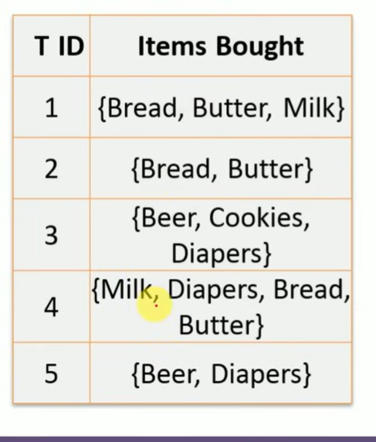
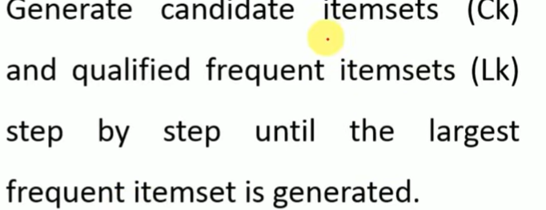

Slide 32
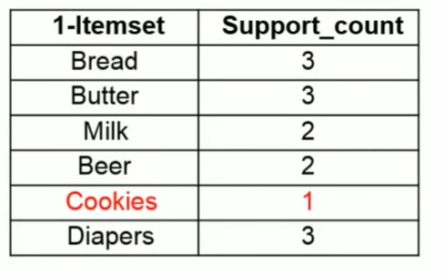
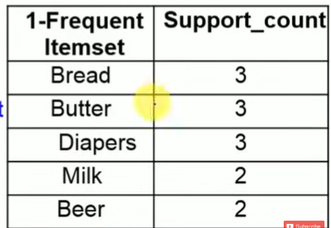
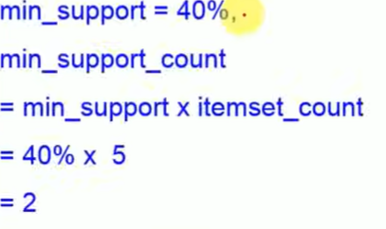

Slide 33
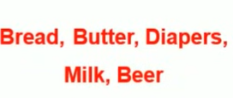
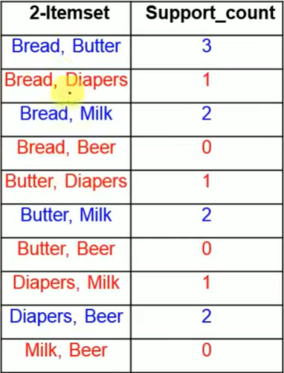
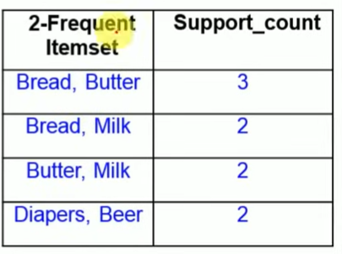

Slide 34

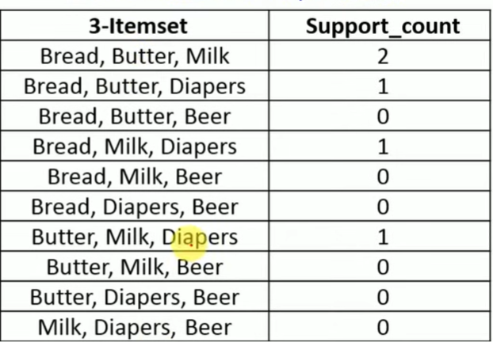
3-Frequent Itemset | Support_count
Bread, Butter, Milk | 2

Slide 35
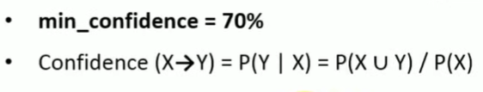
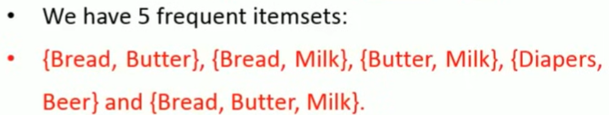
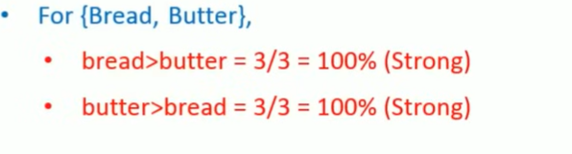
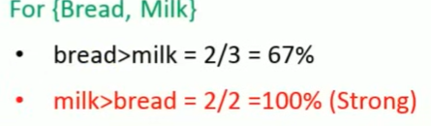
3-Frequent Itemset | Support_count
Bread, Butter, Milk | 2

Slide 36
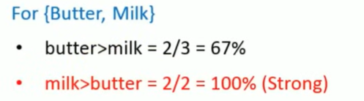
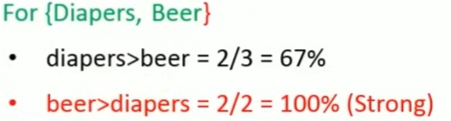
3-Itemset | Support_count
Bread, Butter, Milk | 2

Slide 37
For {Bread, Butter, Milk}
Bread, Butter->Milk = 2/3 = 67%
Bread, Milk -> Butter = 2/2 =100%
Milk, Butter->Bread = 2/2 = 100%
Bread-> Butter, Milk = 2/3 = 67%
Butter -> Bread, Milk = 2/3 = 67%
Milk-> Bread, Butter = 2/2 = 100%
3-Itemset | Support_count
Bread, Butter, Milk | 2

